Slide 1
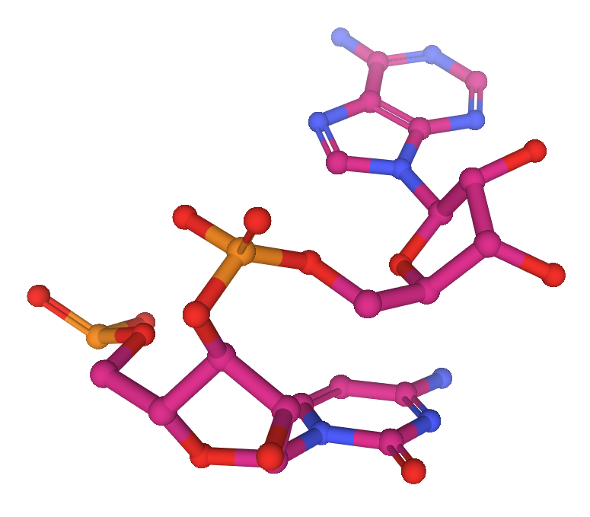
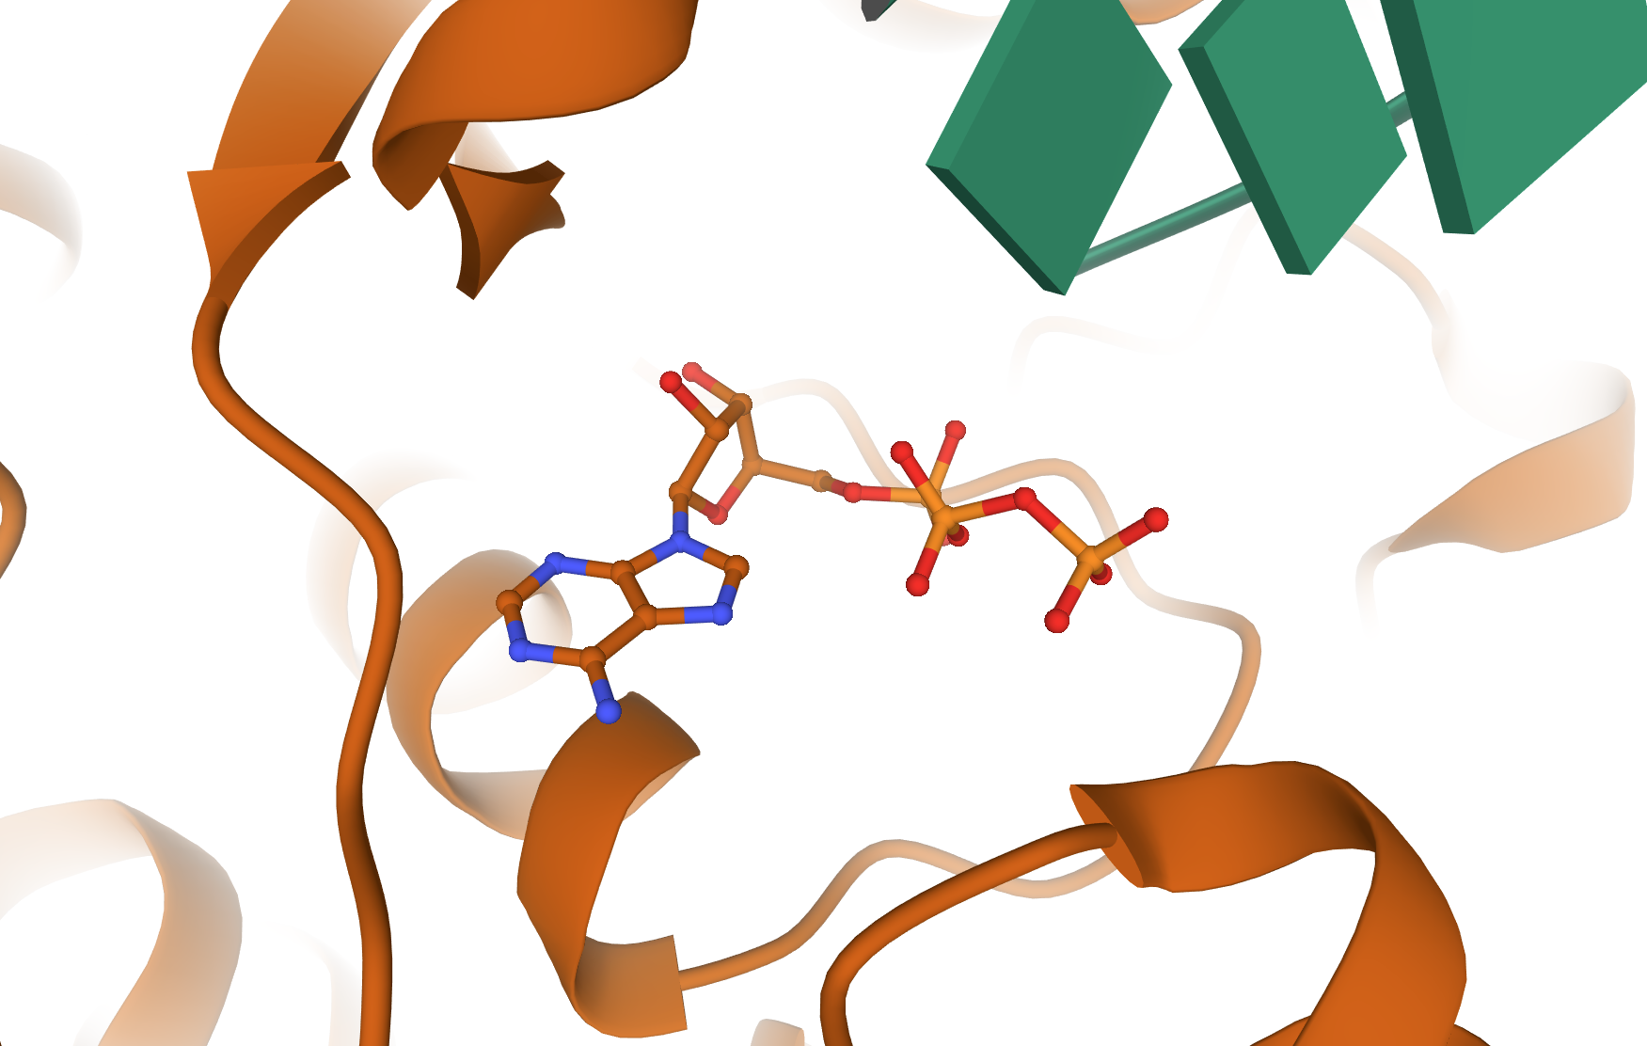
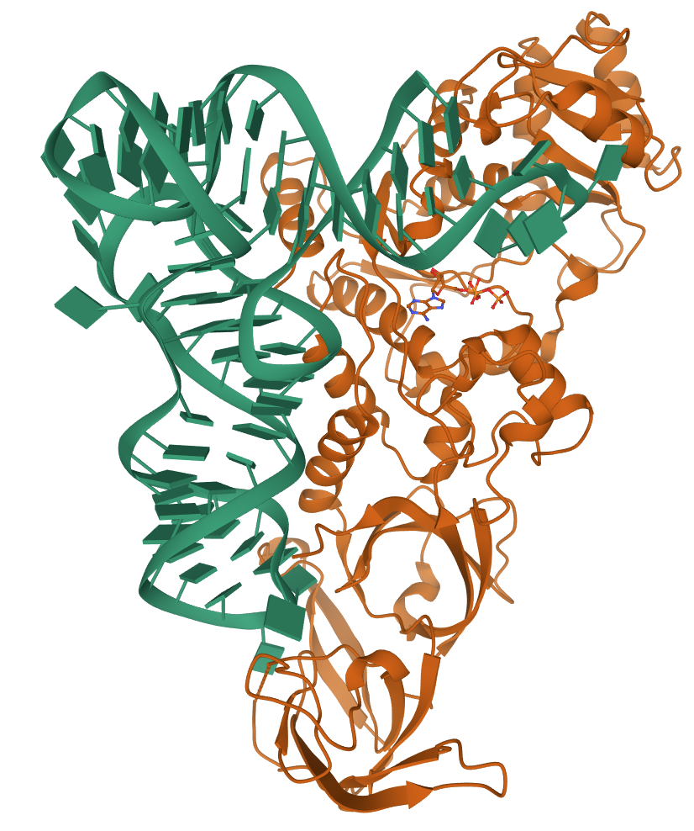

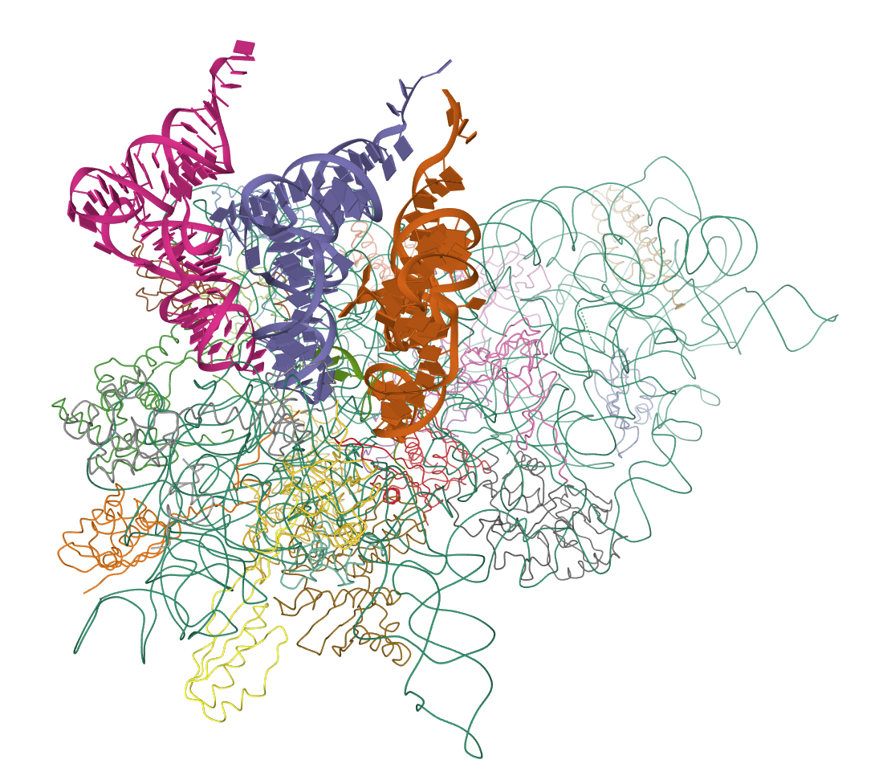
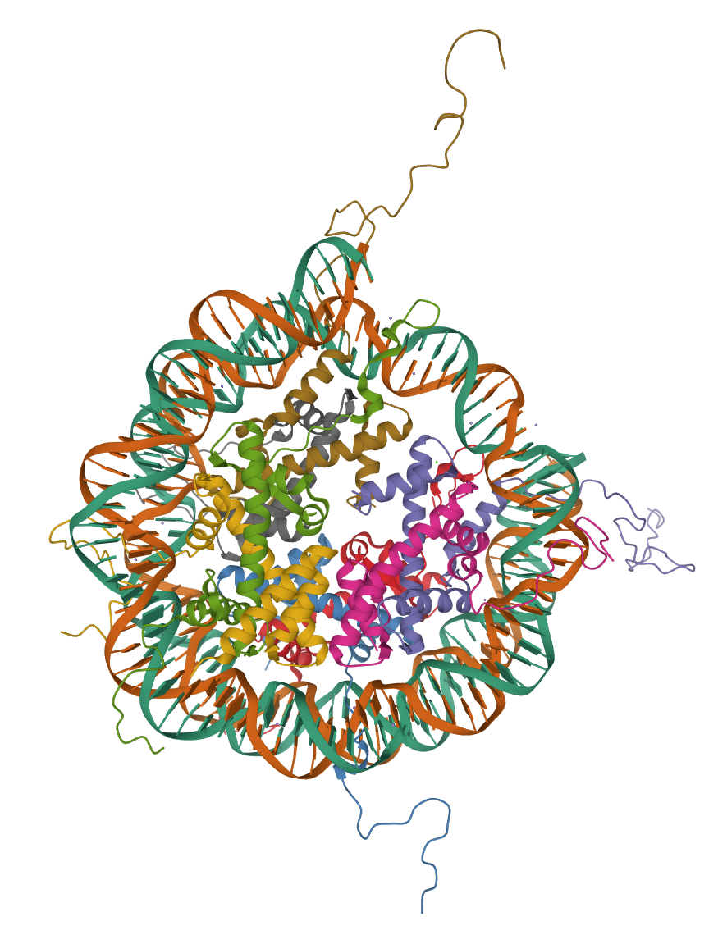
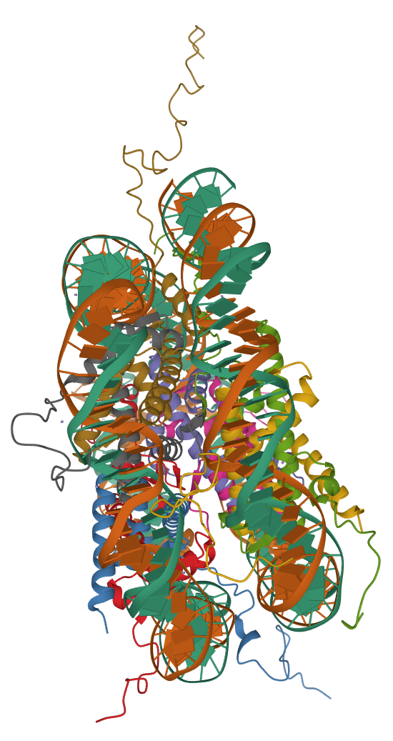
(c)
(b)
tRNA
GGGGUAUCGCCAAGCGGUAAGGCACCGGAUUCUGAUUCCGGCAUUCCGAGGUUCGAAUCCUCGUACCCCAGCCA
tRNA Synthetase
anticodon
tRNA
tRNA
Histone tail
Histone tail
tRNA
(a)
Ribosome
Histone tail
Nucleosome
Histone tail

Slide 2
Nucleosome
Histone tail
Histone tail
(a)
Histone tail
Histone tail

Slide 3
(b)
tRNA
tRNA
tRNA
Ribosome

Slide 4
(c)
tRNA
GGGGUAUCGCCAAGCGGUAAGGCACCGGAUUCUGAUUCCGGCAUUCCGAGGUUCGAAUCCUCGUACCCCAGCCA
tRNA Synthetase
anticodon

Slide 5


Molecular representations
Molecular representations. (a) Shows the structure of the nucleosome core particle [52, 53]. (b) Shows the path of mRNA through the ribosome by pointing out the collinearity between the tRNA anticodons [54, 53]. The window highlights the binding region between an amino acid and a tRNA. (c) Shows the Escherichia coli glutaminyl transfer RNA synthetase complexed with transfer RNA(Gln) and ATP [55, 53]. The tRNA sequence is presented next to this ribonucleoprotein particle. The last letters in the sequence correspond in reverse order to the region in the tRNA highlighted by the dotted line window (i.e. “ACCG …”). The position of the tRNA anticodon is also highlighted here..
Cite this work as:
Paul A. Gagniuc. Algorithms in Bioinformatics: Theory and Implementation. John Wiley & Sons, Hoboken, NJ, USA, 2021, ISBN: 9781119697961.

